Slide 1

DEPARTMENT OF STATISTICAL SCIENCES
SECOND CYCLE DEGREE IN STATISTICAL SCIENCES
LOCAL EFFECTS AND NON-LINEAR MODELING FOR IMPROVED PREDICTION ACCURACY IN REGRESSION AND CLASSIFICATION: AN R PACKAGE IMPLEMENTATION
Supervisor Prof. Cinzia Viroli
Co-Supervisor Prof. André Osório Falcão
Defended by
Emanuele Tartaglione
0001037146
Graduation Session II / December / 2023 Academic Year 2022/2023

Slide 2
MS-QSAR
Metric Space – Quantitative Structure Activity Relationship
Previous work:
A new Machine Learning Algorithm developed by prof. André Falcão in Python
Analysing chemical databases: evaluate, test, predict and screen
Classification and Regression
Make uses of distances (similar to K-Nearest Neighbours) and supervised learning methods (Support Vector Machines and Random Forests)
Reading only .sar files

Slide 3
MS-QSAR
Metric Space – Quantitative Structure Activity Relationship
My work:
Make the algorithm of general use, suitable for every kind of data set
Write an R version to reach a broader community of users
Focus on the prediction

Slide 4
MS-QSAR
Metric Space – Quantitative Structure Activity Relationship
Comparison with the State of Art:
Logistic Regression
K-Nearest Neighbours
Random Forest
Support Vector Machines
Data sets:
Classification:
Breast Cancer
Covertype
Diabetes
Regression:
Auto
Boston Housing
Forest Fires

Slide 5
Algorithm Description
Split the data into train and test
It uses the idea of closest neighbours (Euclidean distance) with some parameters:
Minimum size : minimum number of closest neighbours
Maximum size : maximum number of closest neighbours
Maximum distance : the maximum distance from the test point to the non-test points to be considered
distance = mean(distance train matrix) × max dist
When max dist = 1, the distance is the average distance in the training distance matrix

Slide 6
Input
Matrix of independent variables
Vector of dependent variable
Percentage of training data
Minimum size
Maximum size
Maximum distance
Seed
Model type - SVM or RF
k - kernel in SVM algorithm
cost - cost in SVM algorithm
ntrees - number of trees in the RF algorithm

Slide 7
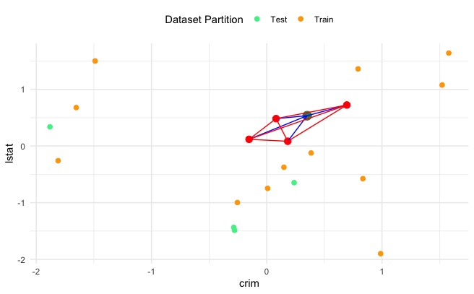
Parameters:
min size = 3
max size = 4
max dist = 0.5
Dataset: Boston Housing

Slide 8
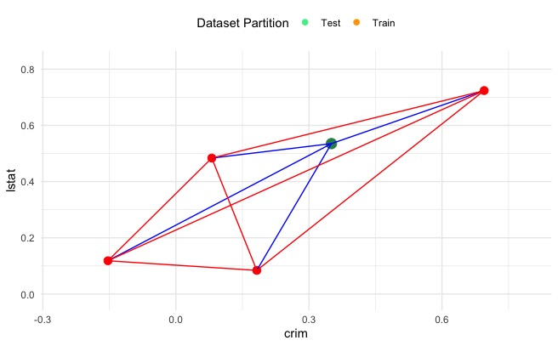
Parameters:
min size = 3
max size = 4
max dist = 0.5
Blue lines will create a Test Matrix (1 x n)
Red lines will create a Training Matrix (n x n)
n = number of closest neighbours
Dataset: Boston Housing

Slide 9
Algorithm Description
For each test observation, if the test value has close neighbours satisfying the parameters (min size, max size and max dist), a test matrix and a training matrix are created
Then, predict a value using SVM or RF and store it in a vector of predictions
If a test value does not have close neighbours satisfying the parameters (min size, max size and max dist), it is not taken into account

Slide 10
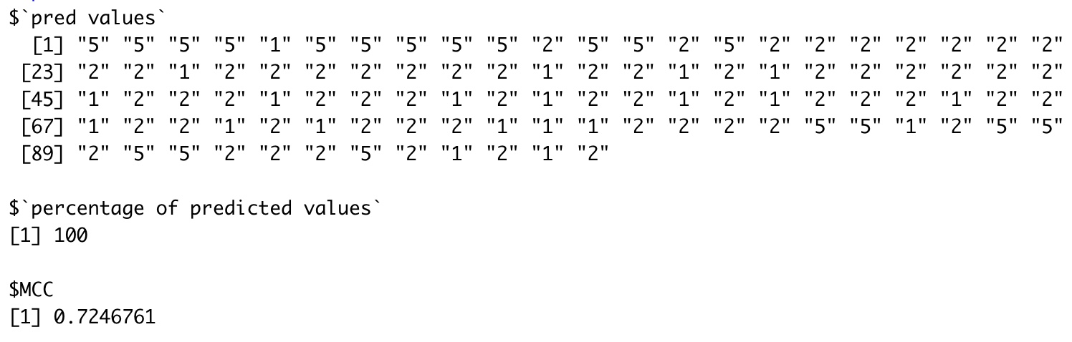
Output
Vector of predicted values
Percentage of predicted values
Accuracy measure (MCC for classification, MSE for regression)

Slide 11
Analysis
Greedy Search, parameters initialized as:
Minimum size: 3, 4, 5
Maximum size: 6, 8, 10
Maximum distance: 0.5, 1, 1.5
MS-QSAR with SVM
SVM with radial kernel and fixed cost (1)

Slide 12
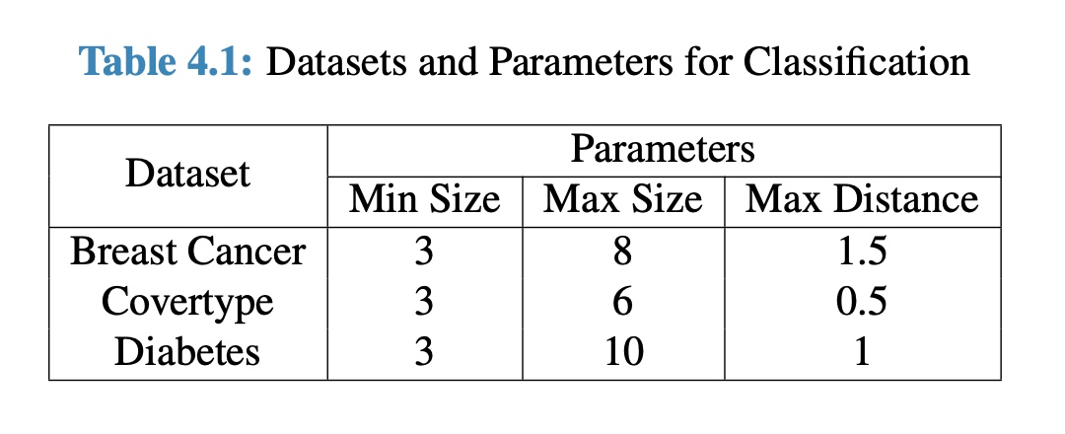
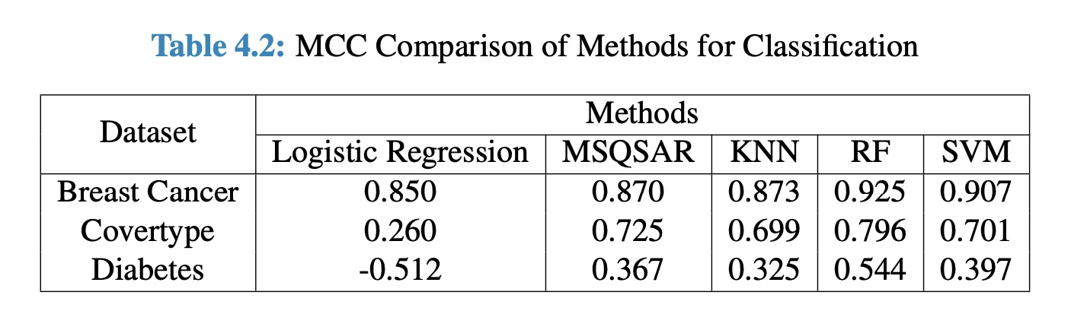
Results (Classification)

Slide 13
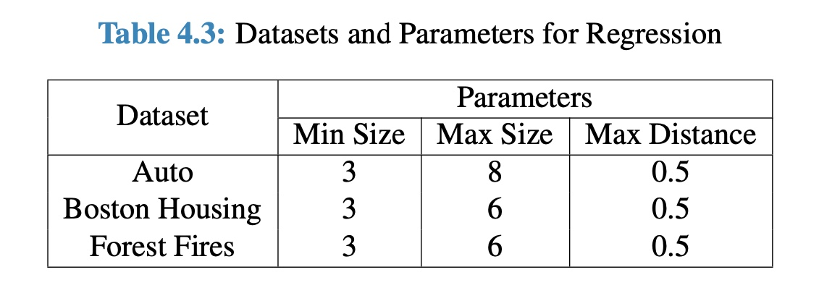
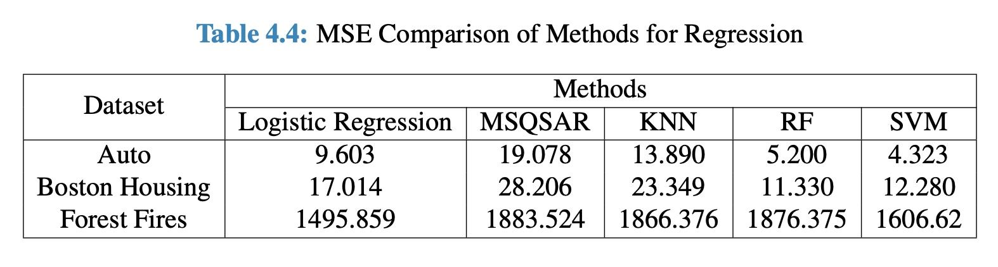
Results (Regression)

Slide 14
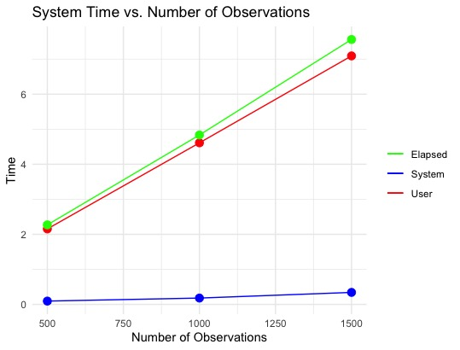
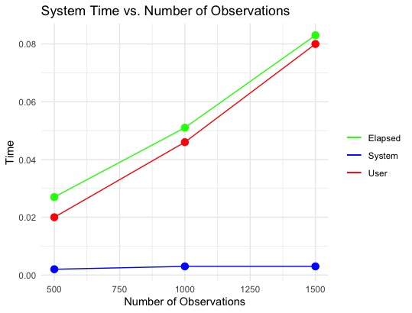
System Time
MS-QSAR
SVM
Dataset: Covertype

Slide 15
Limitations and Future Work
Introduce Minimum Hashing Algorithm to solve the problem of storing the matrices
Use another kind of distance (Mahalanobis or Jaccard) instead of Euclidean
A formula to define the parameters (min size, max size and max dist) instead of tuning
Use other metrics instead of MCC or MSE (Accuracy, MAE, etc..)
Develop an R package similar to already existing packages for supervised learning like “e1071” or “randomForest”

Slide 16
Conclusions
Link to the Python version:
https://github.com/aofalcao/msqsar
Link to the R version
https://github.com/EmanueleTartaglione/MS-QSAR

Slide 17
Thank you for your attention!

